Slide 1
Steps 18- Launch EC2 instance in AWS

Slide 2
AWS
AWS is type of cloud computing which provided different types of services.
Amazon Web Service : it is web service provide lot of module Like
S3
EBS
EC2
RDS

Slide 3
EC2 instance
EC2 instance : Elastic Cloud Compute is a type of aws module which provide virtual lab.
Using EC2 we can create server machine with depending upon os like window, linux, unix or mac.
We need to connect that instance using SSH client ie
In window using putty or git terminal provide that features.
In Linux or unix normal terminal provide that features.
And we need to install required software in that instance
So we run any angular or express js project that project we can access through IP address of that instance provided by EC2 part of AWS.

Slide 4
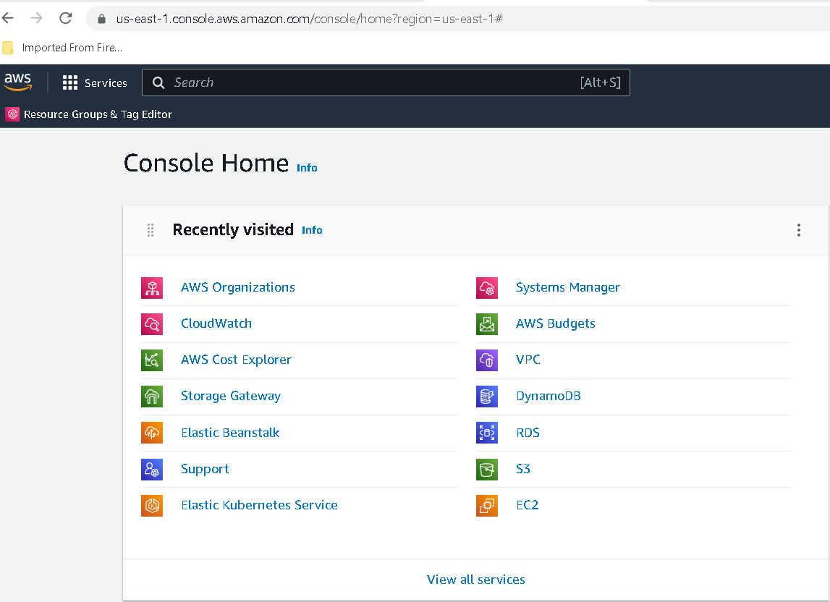
Now we do the login for aws

Slide 5
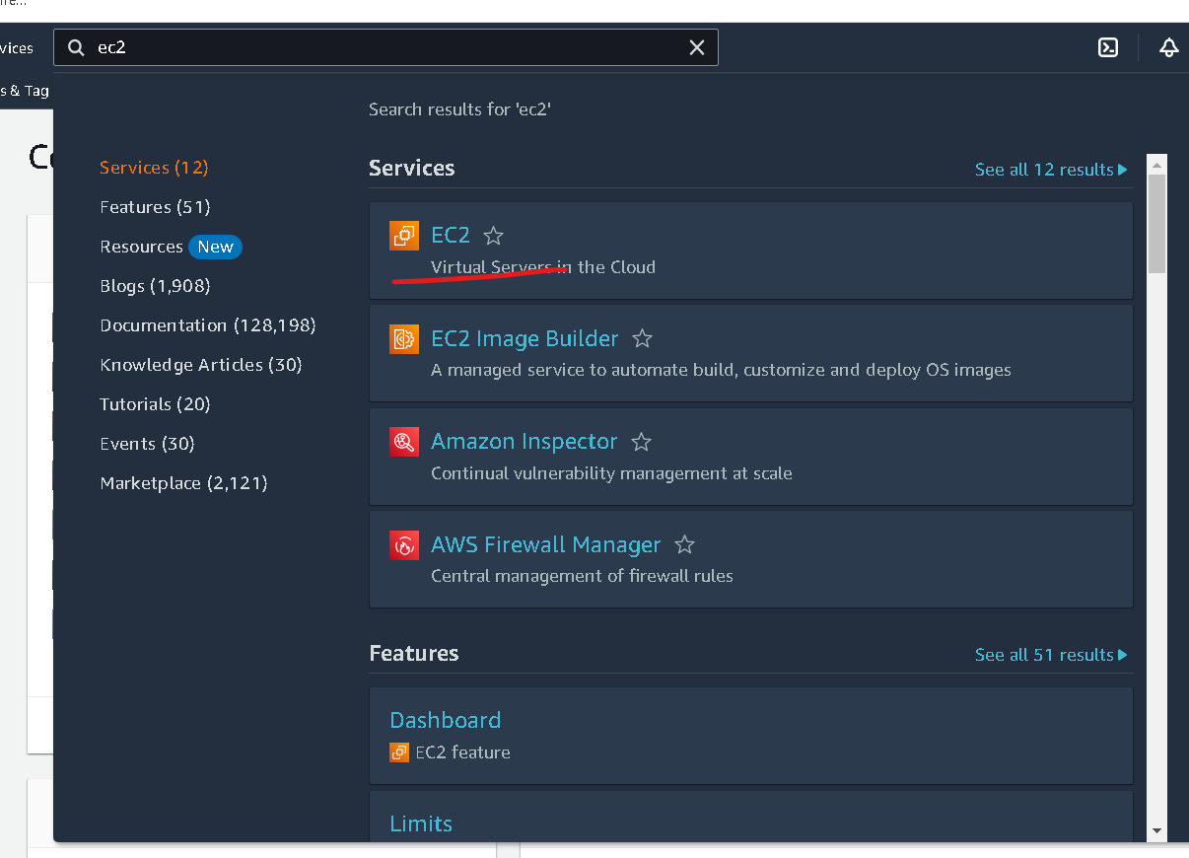
In Search bar search EC2 instance

Slide 6
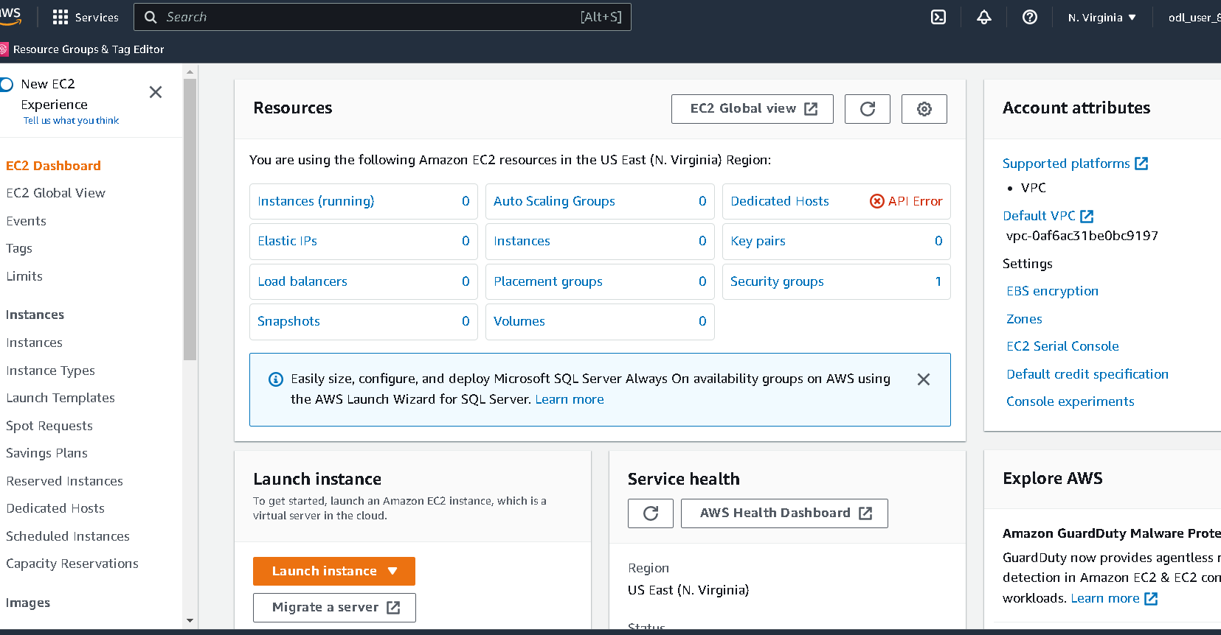

Slide 7
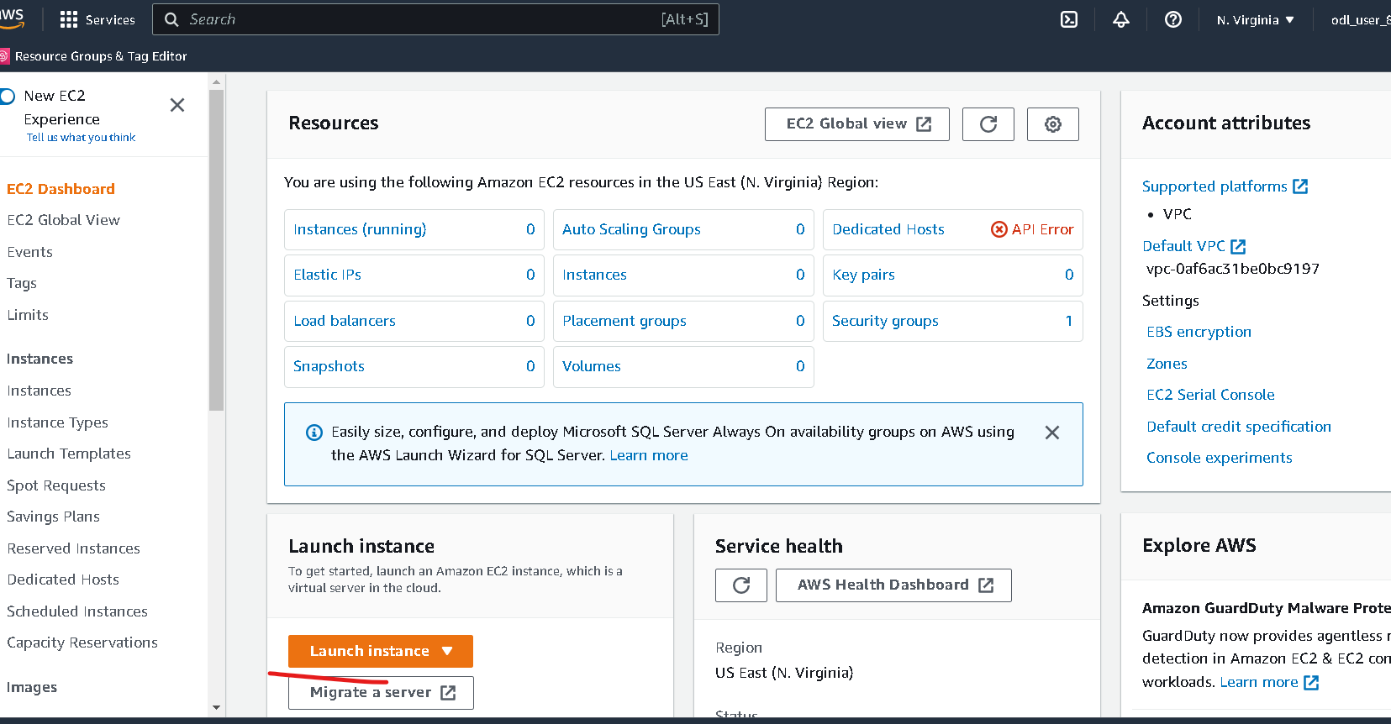
Now you have to click on launch button

Slide 8
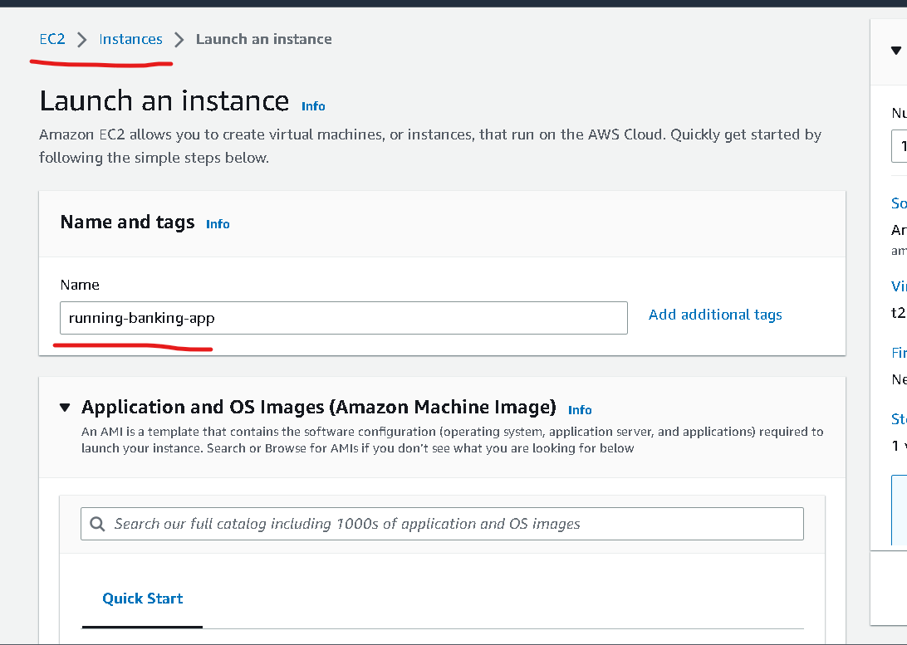
Instance name can be anything :phase2-instance

Slide 9
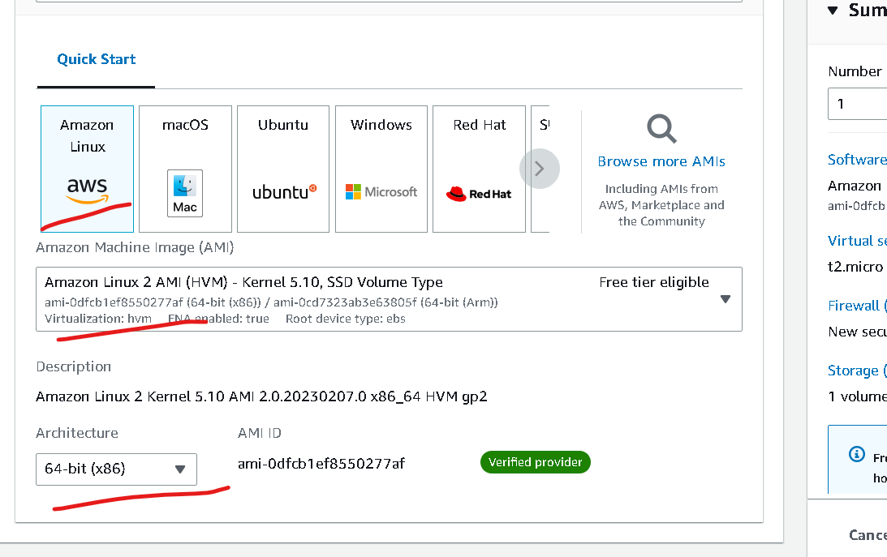
No changes – default option

Slide 10
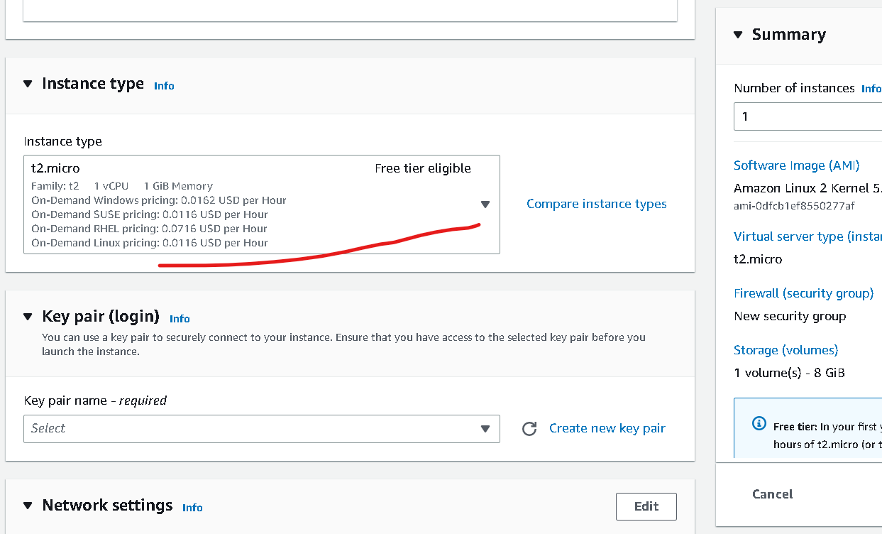
Instance type – free tier (don’t change)

Slide 11
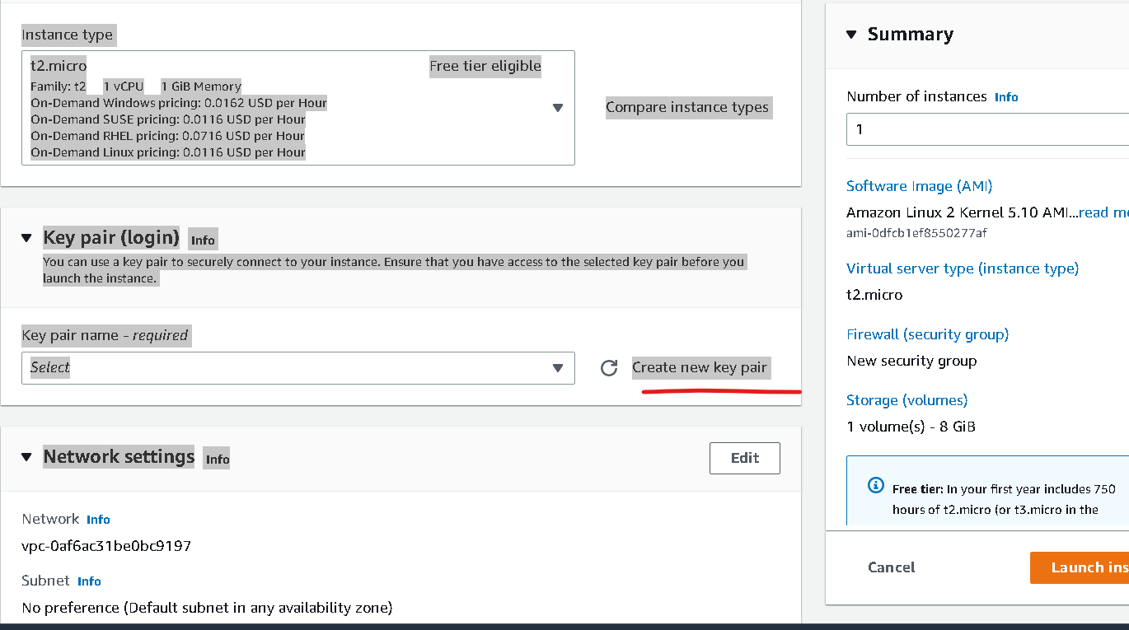
Click on create key

Slide 12
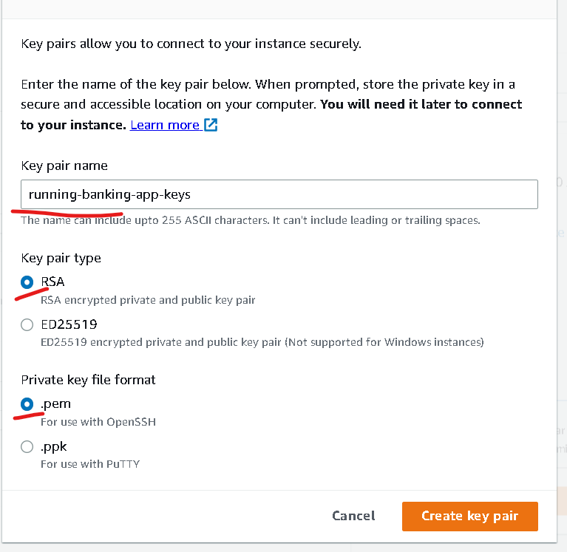
Create the key (please remember path of the file which help to connect to instance )
Keyname is phase2-keys
Private key file format
.pem
If client is SSH client you can create
In MAC or unix we can use normal terminal as SSH client but in window we have to use gitbash which support SSH client
.ppk : this for window with putty tool.

Slide 13
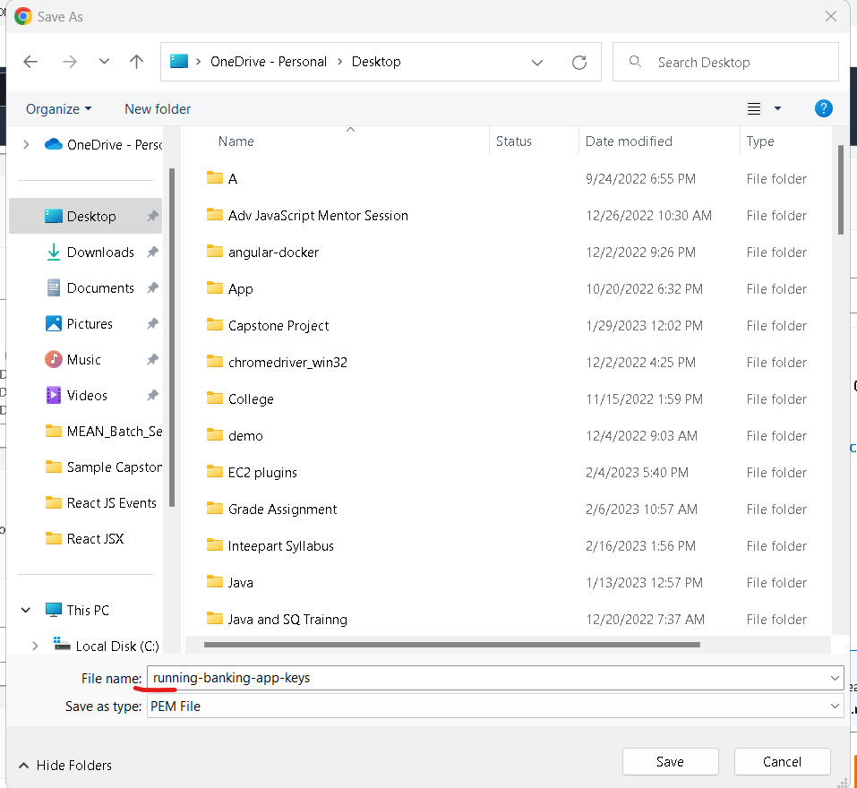

Slide 14
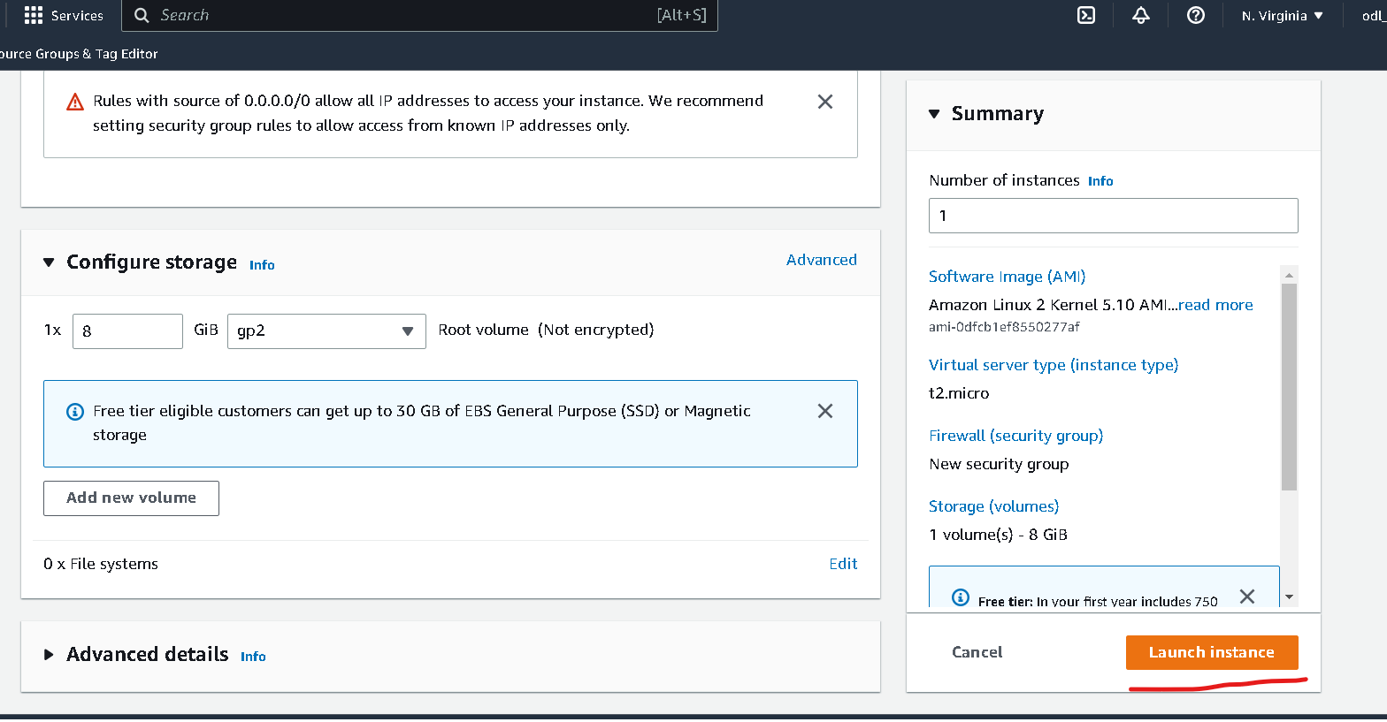
Other option are default don’t do any changes

Slide 15
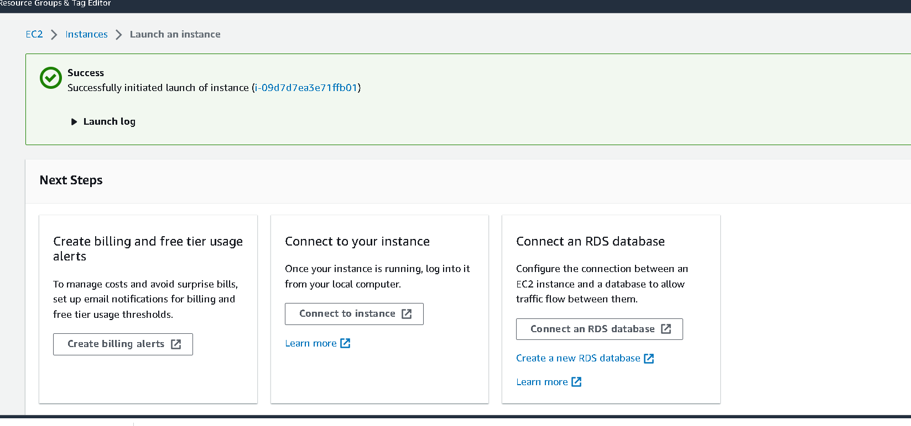

Slide 16
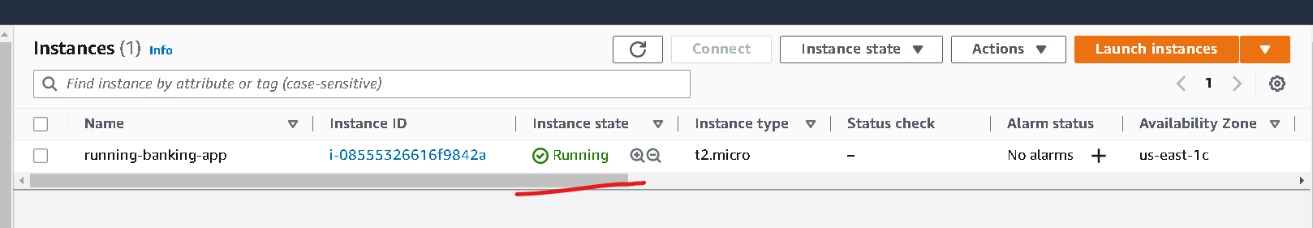
Wait for few minutes to instance to run

Slide 17
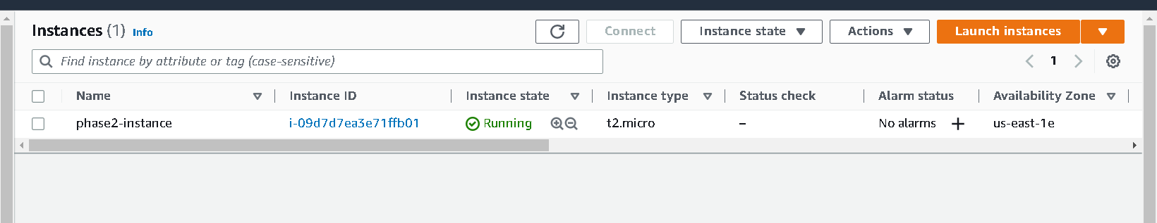
Once instance up

Slide 18
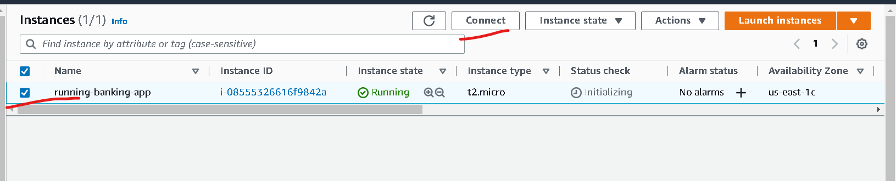
Now click on check box of instance and click on connect

Slide 19
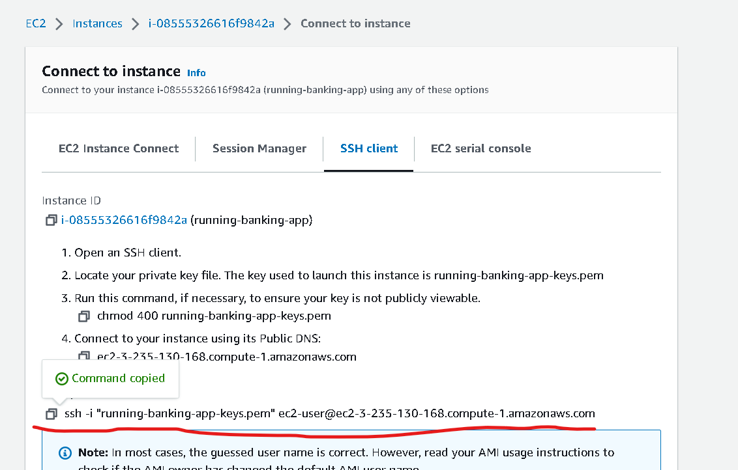
Now you have to copy and example code content which help to connect running instance through ssh client

Slide 20
Steps to connect instance
If you are connecting from window please using gitbash. Open gitbash in the location where .pem file present
If you are connecting from unix or mac. Please open terminal in that location where .pem file present.

Slide 21
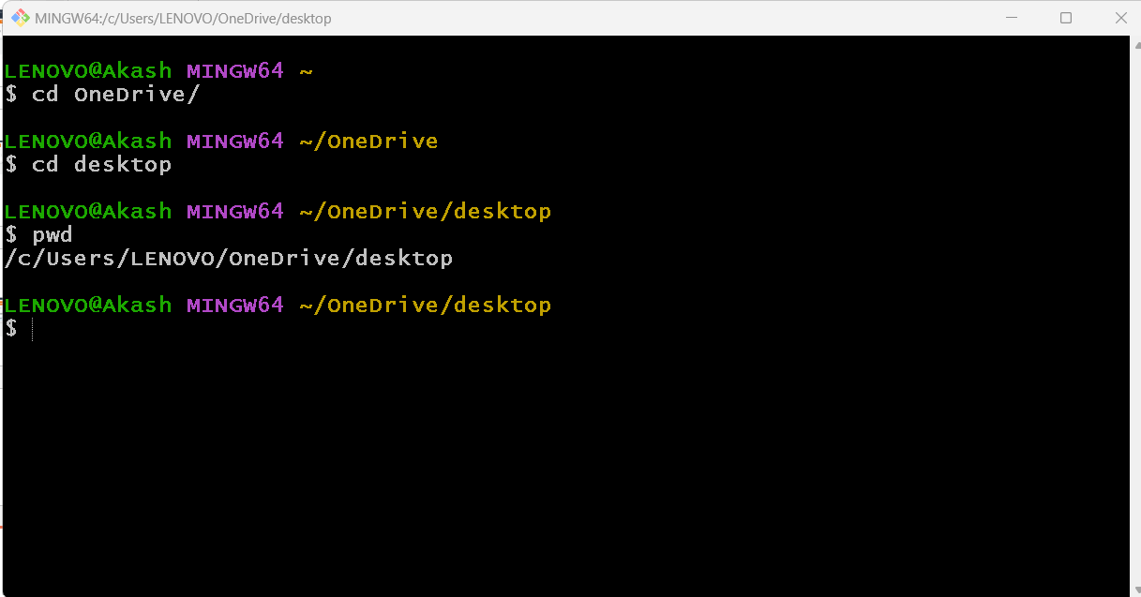
My file present in desktop so I have point to desktop using gitbash

